Slide 1
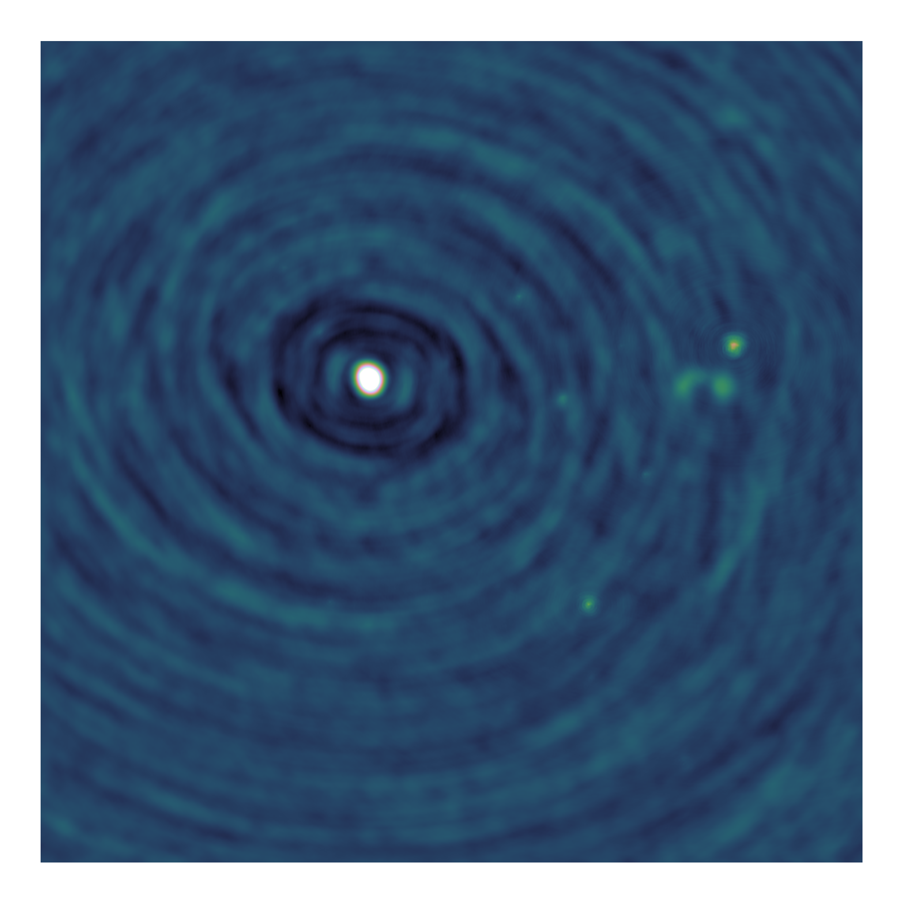
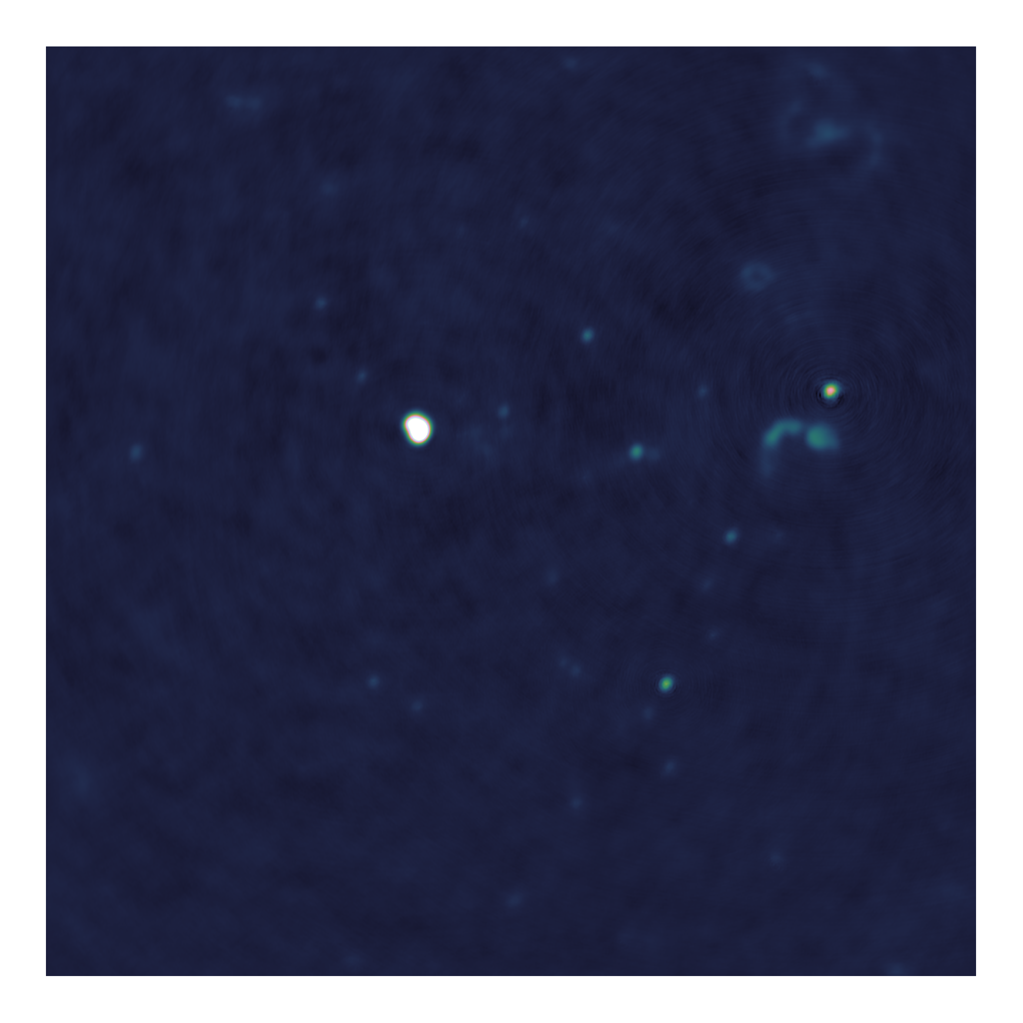
Towards distributed image reconstruction for radio interferometers

Slide 2
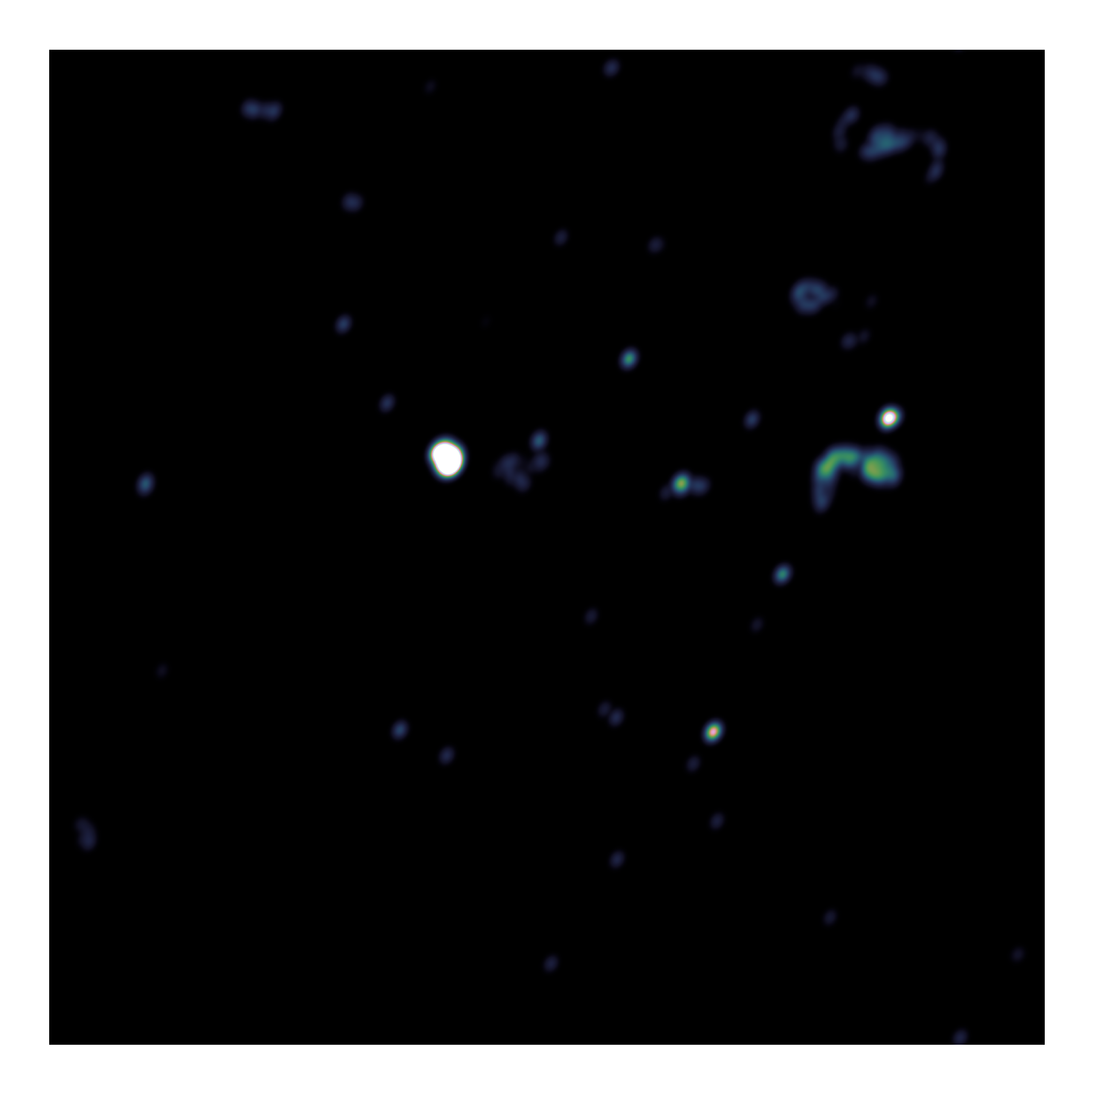
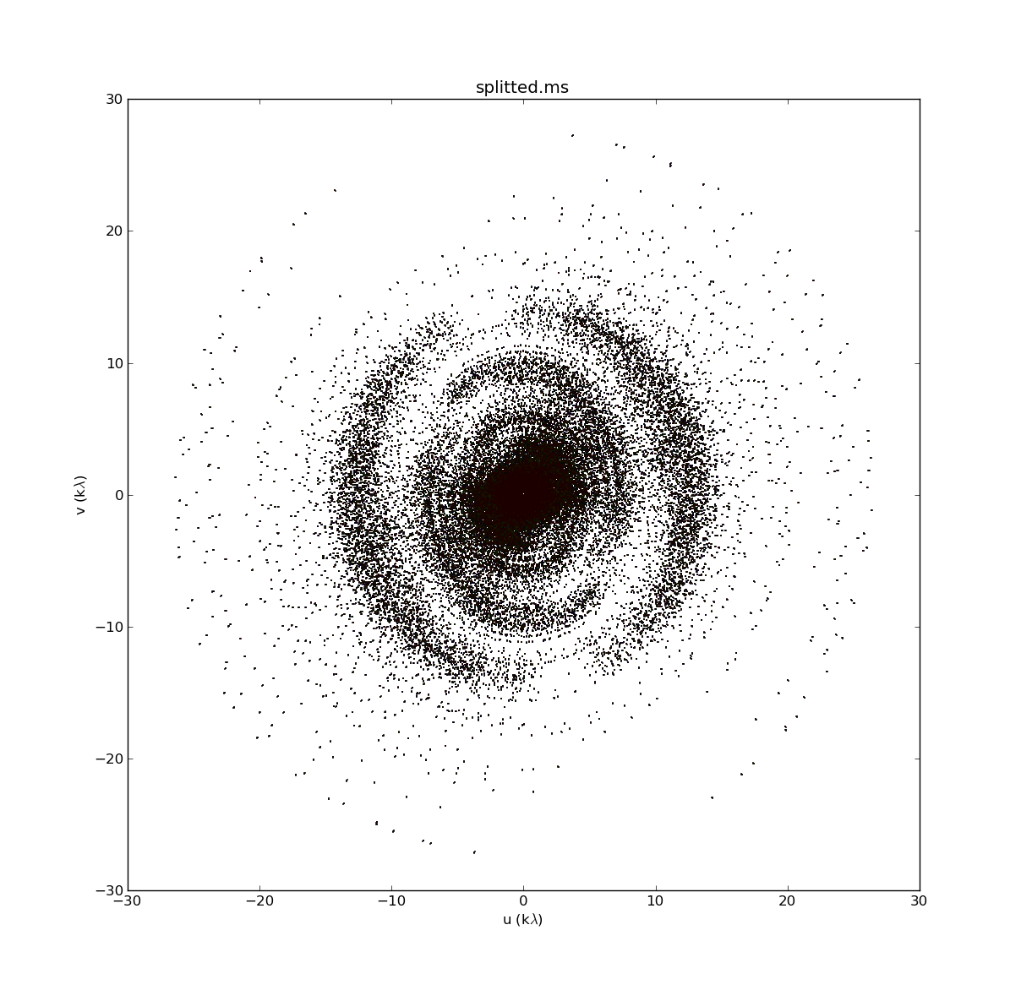
Image reconstruction problem
Fourier Measurements
Dirty Image
Model Image
Fourier Transform
Deconvolution

Slide 3
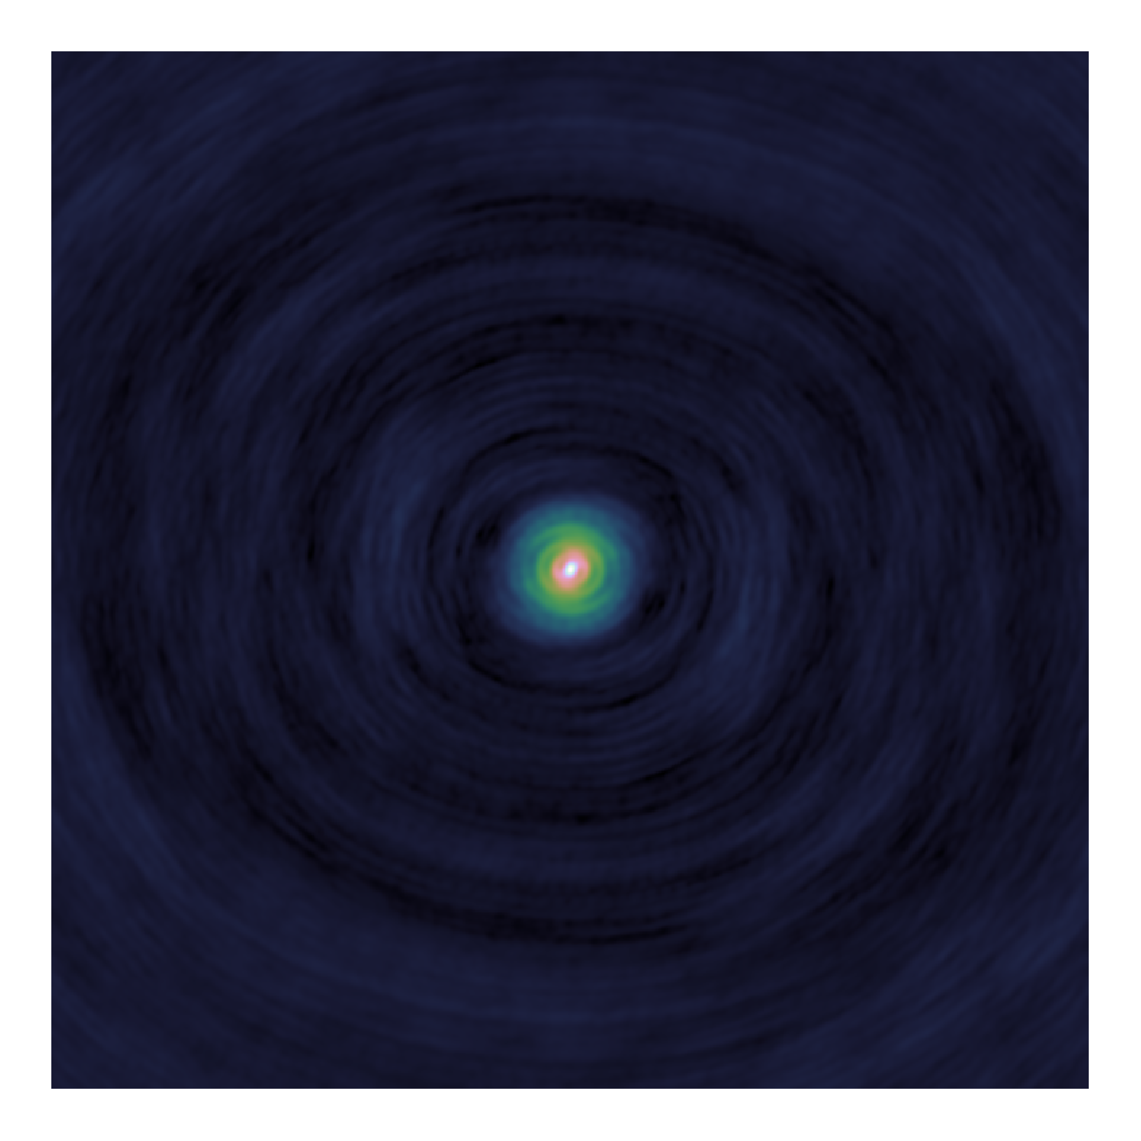
Deconvolution
Dirty
Image
Model
Image
PSF

Slide 4
Major/Minor Cycle
Fourier Transform
Deconvolution(Minor cycle)
Dirty
Image
Model
Fourier C.
Residual
Fourier C.
Model
Image
PSF
Fourier Transform

Slide 5
Deconvolution algorithms
CLEAN
Serial Coordinate Descent
Parallel Coordinate Descent + PSF Approximation

Slide 6
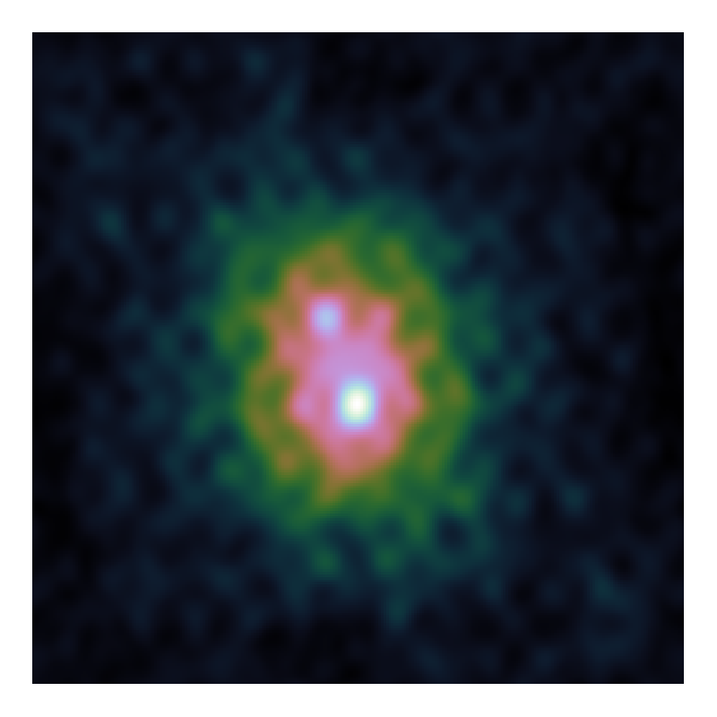
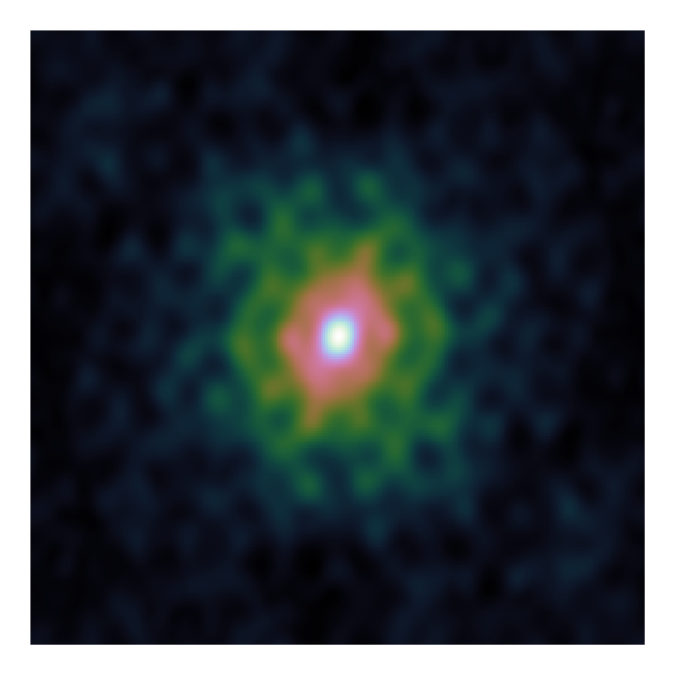
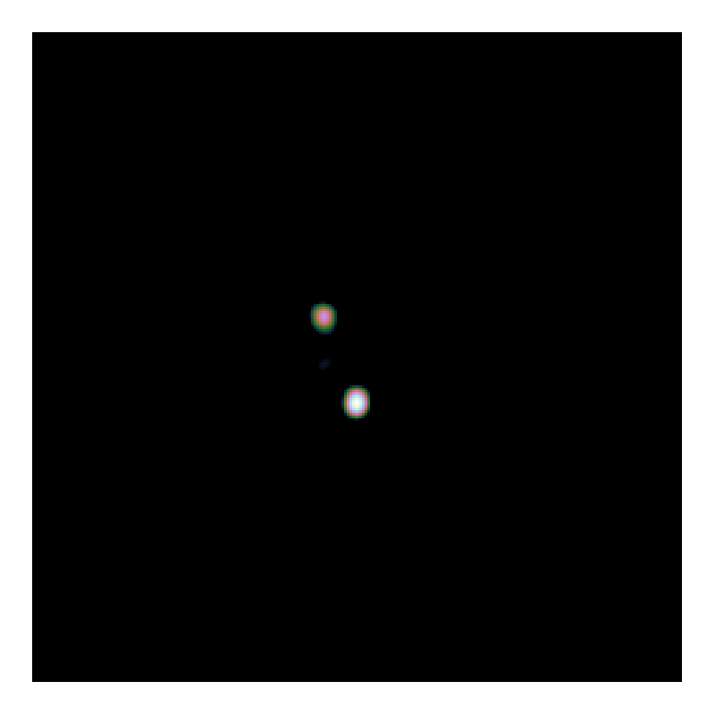
Example deconvolution problem
Dirty Image
PSF
Model Image

Slide 7
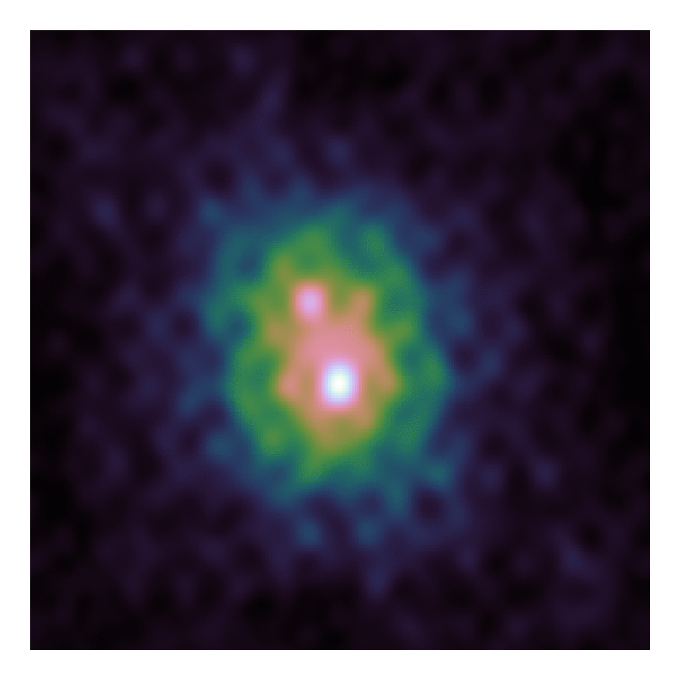

CLEAN
Dirty Image
Model Image

Slide 8
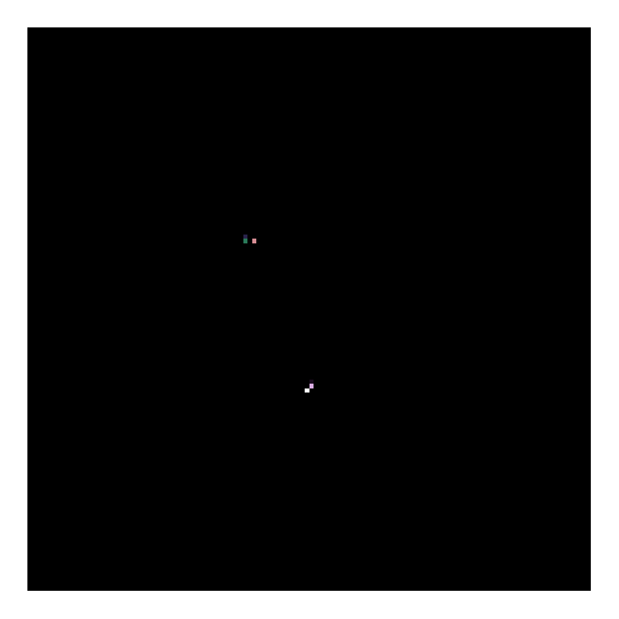
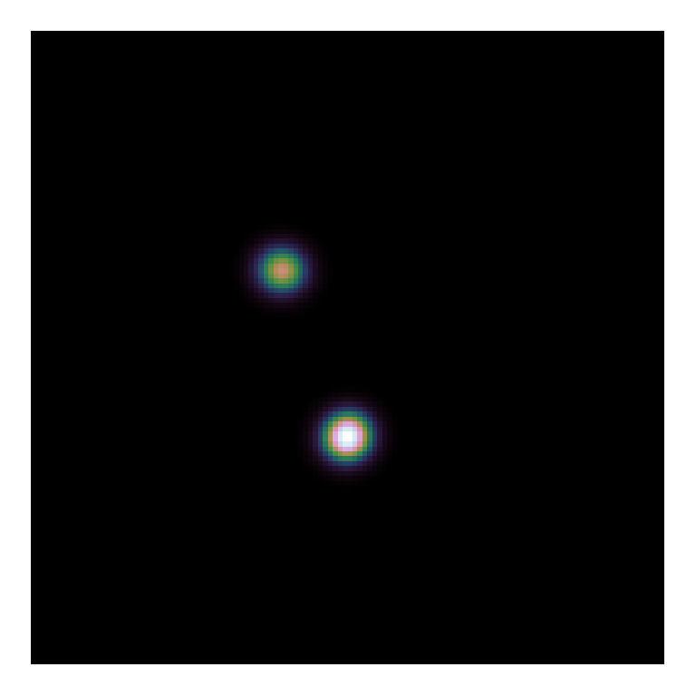
CLEAN
Model Image
Restored Image

Slide 9
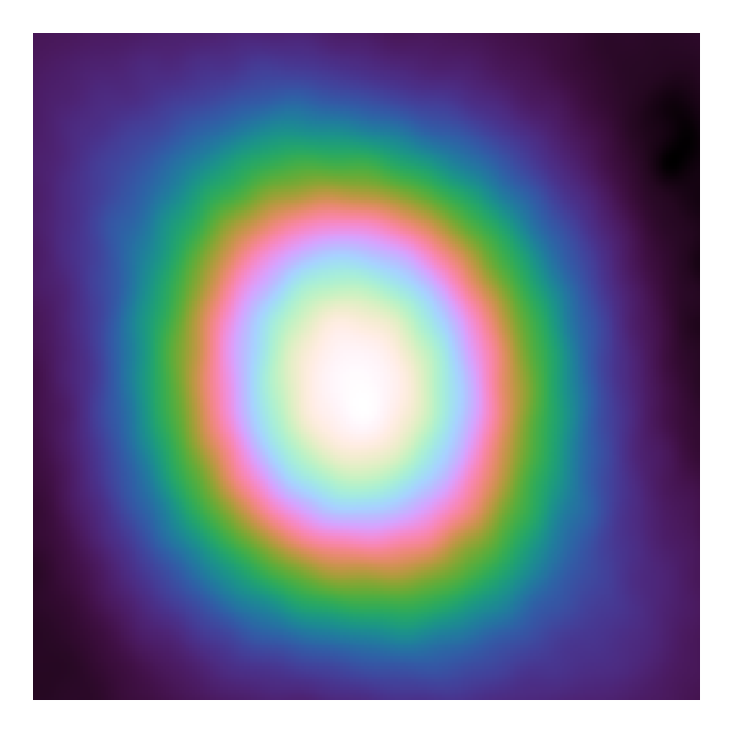
Serial Coordinate Descent
Gradient Map
Dirty Image

Slide 10
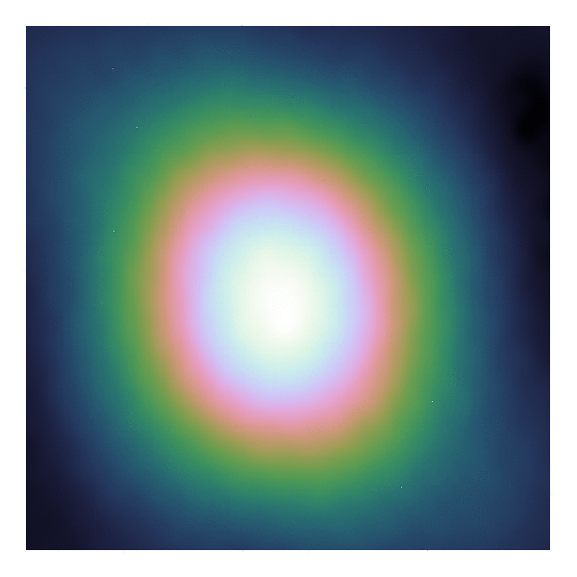

Serial Coordinate Descent
Gradient Map
Model Image

Slide 11
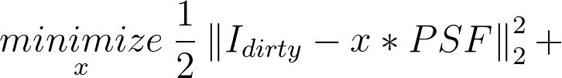
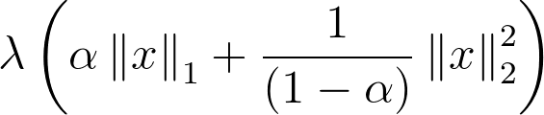
Serial Coordinate Descent
Model image close to measurements
Model image is plausible

Slide 12
Serial Coordinate Descent
Deconvolution objective
Plausible model Image
Image contains stars…
…But also
clouds of gas/dust

Slide 13
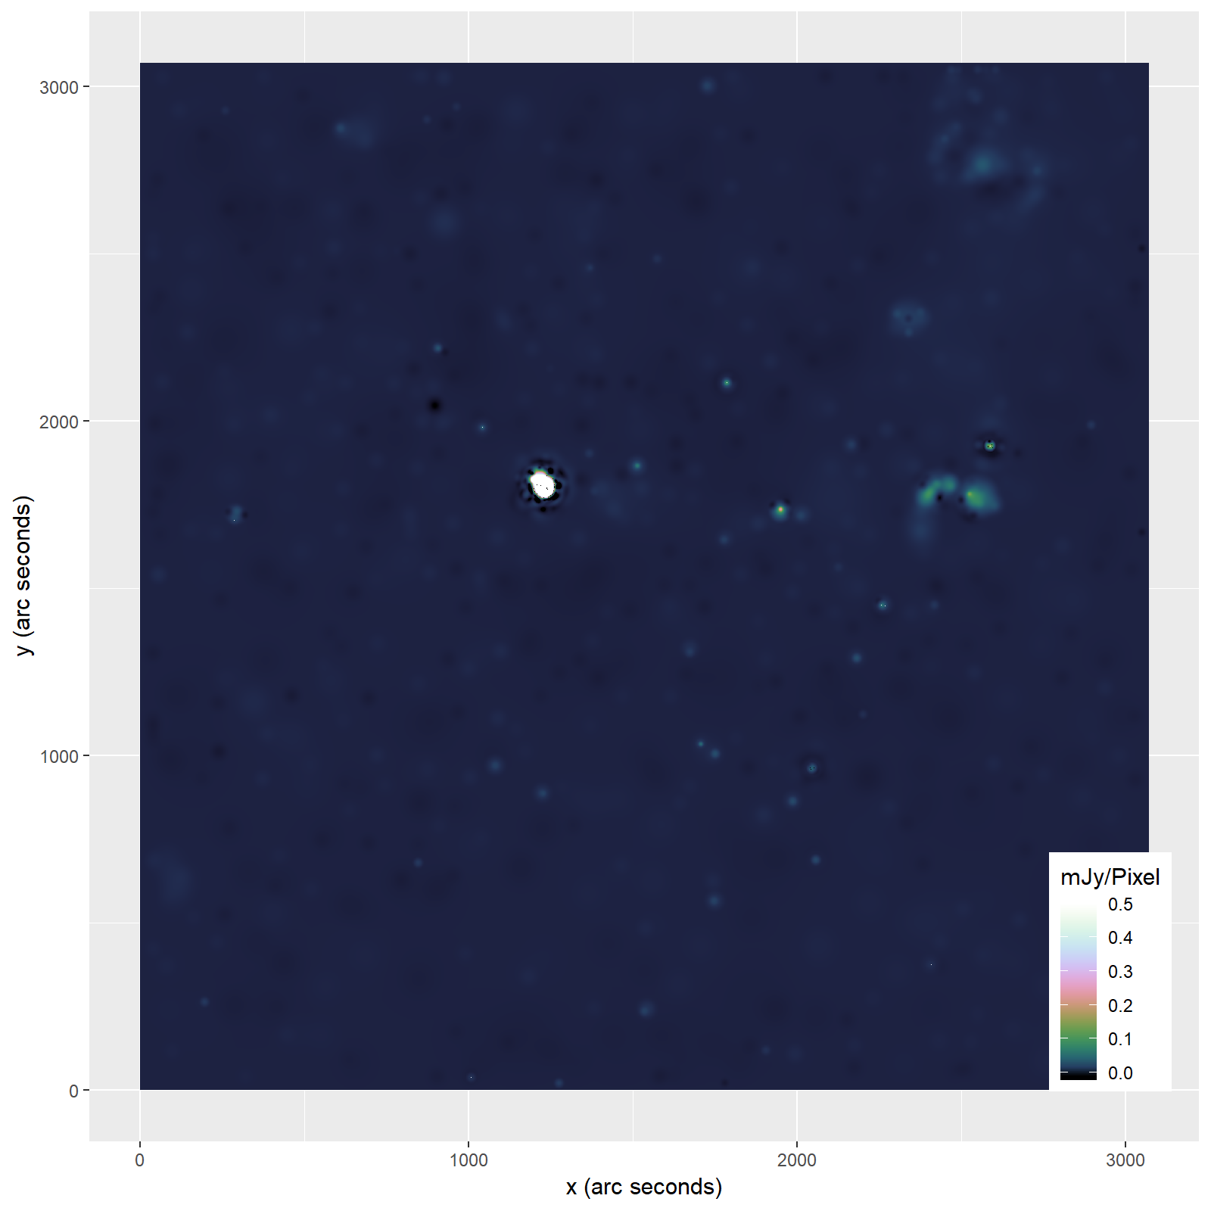

Slide 14
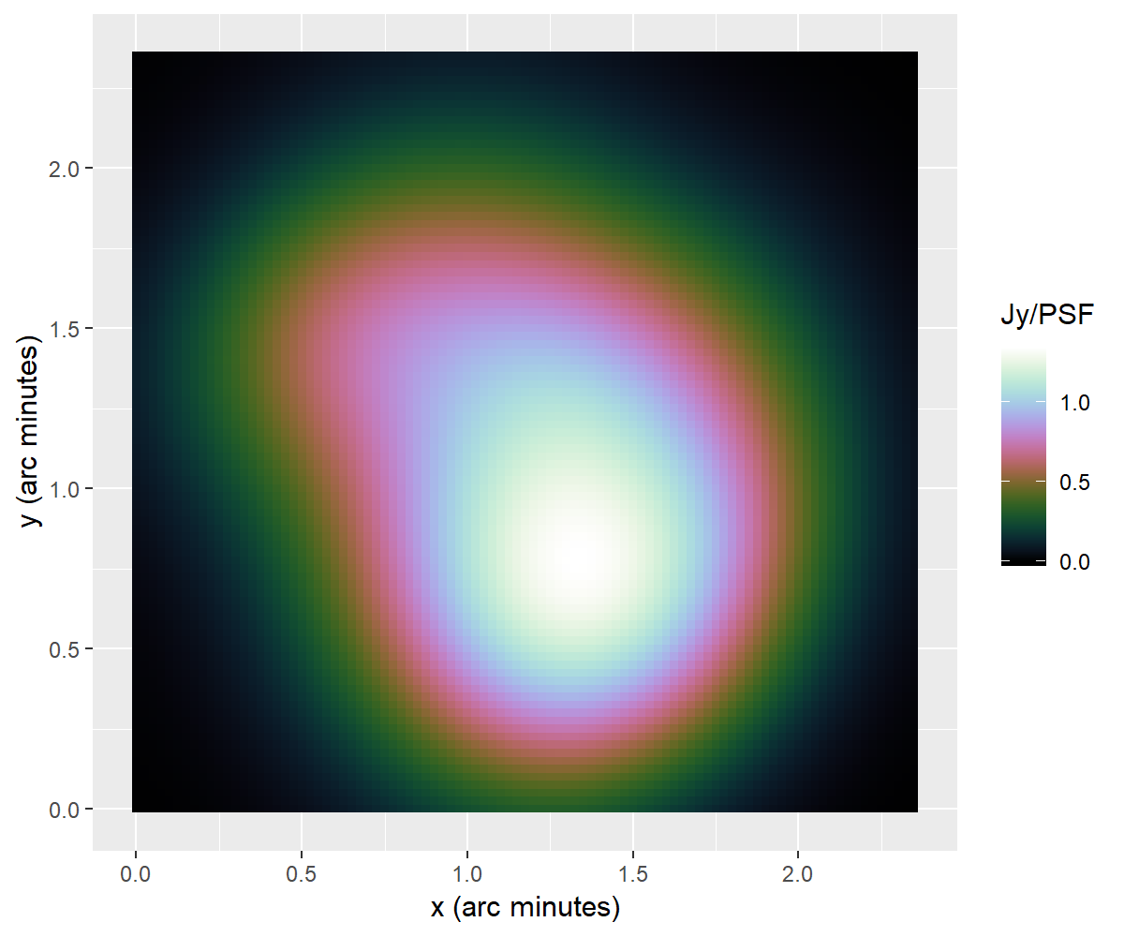
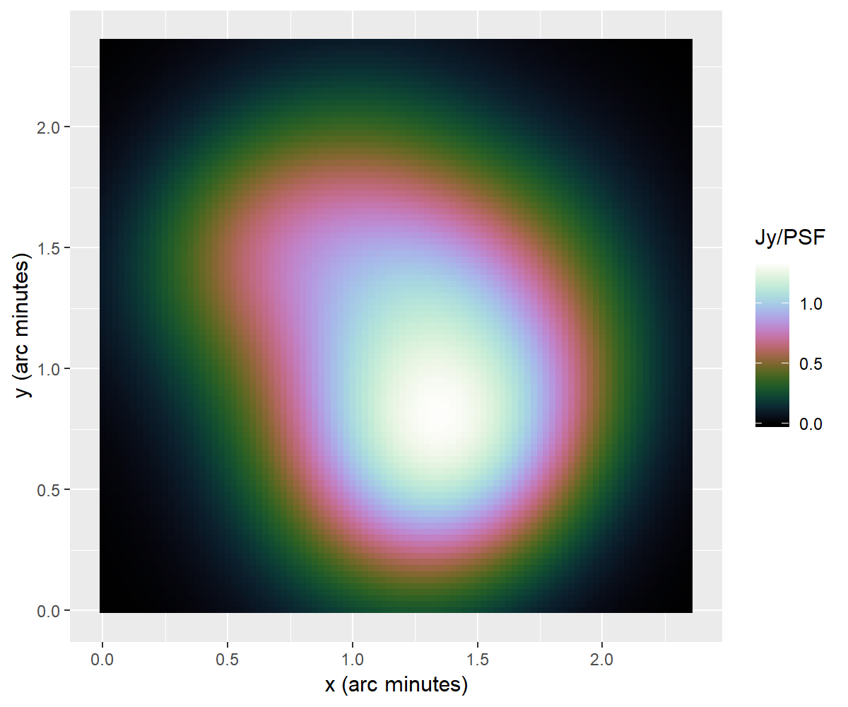
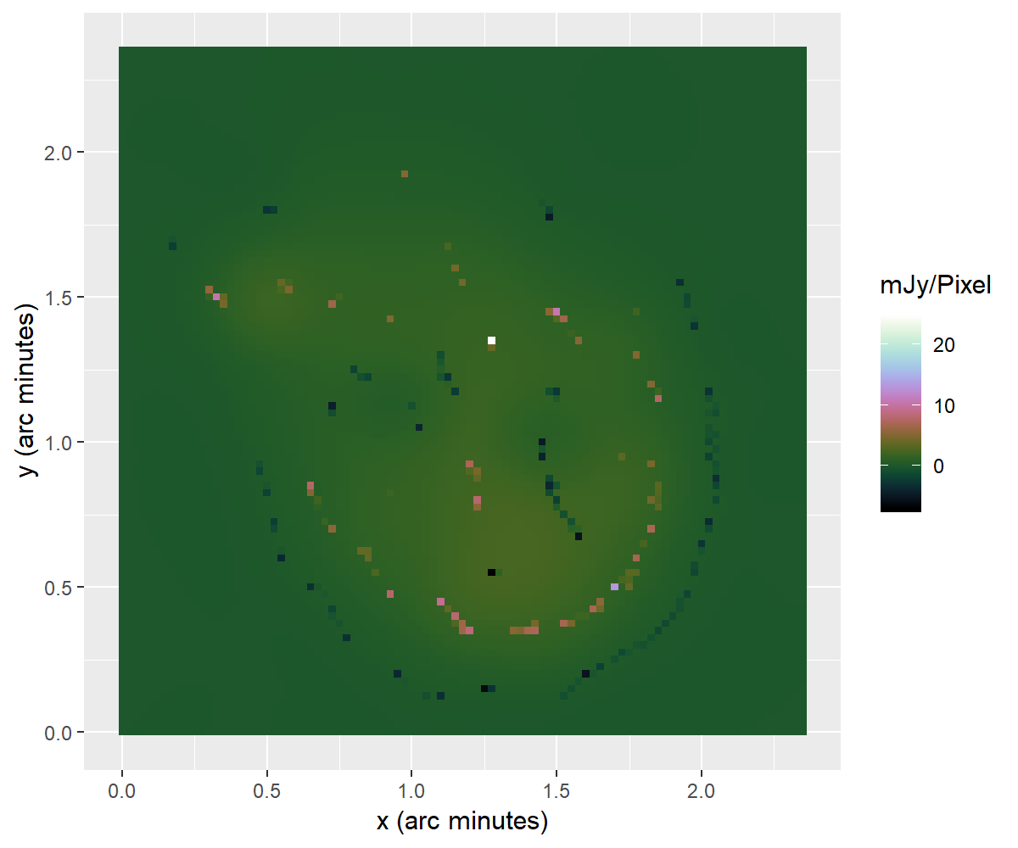
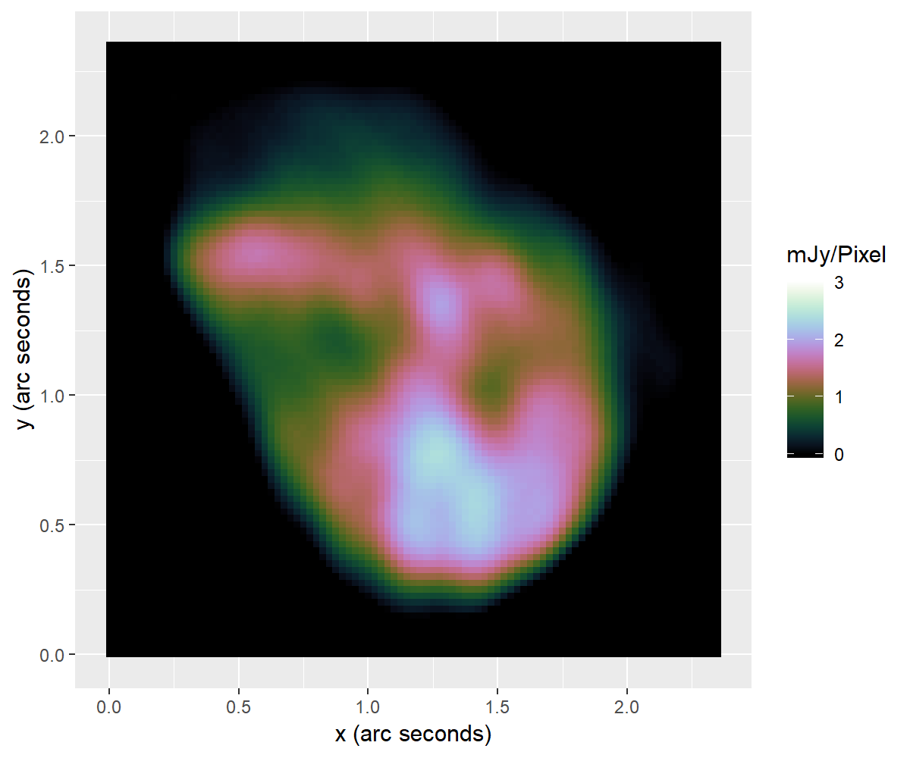
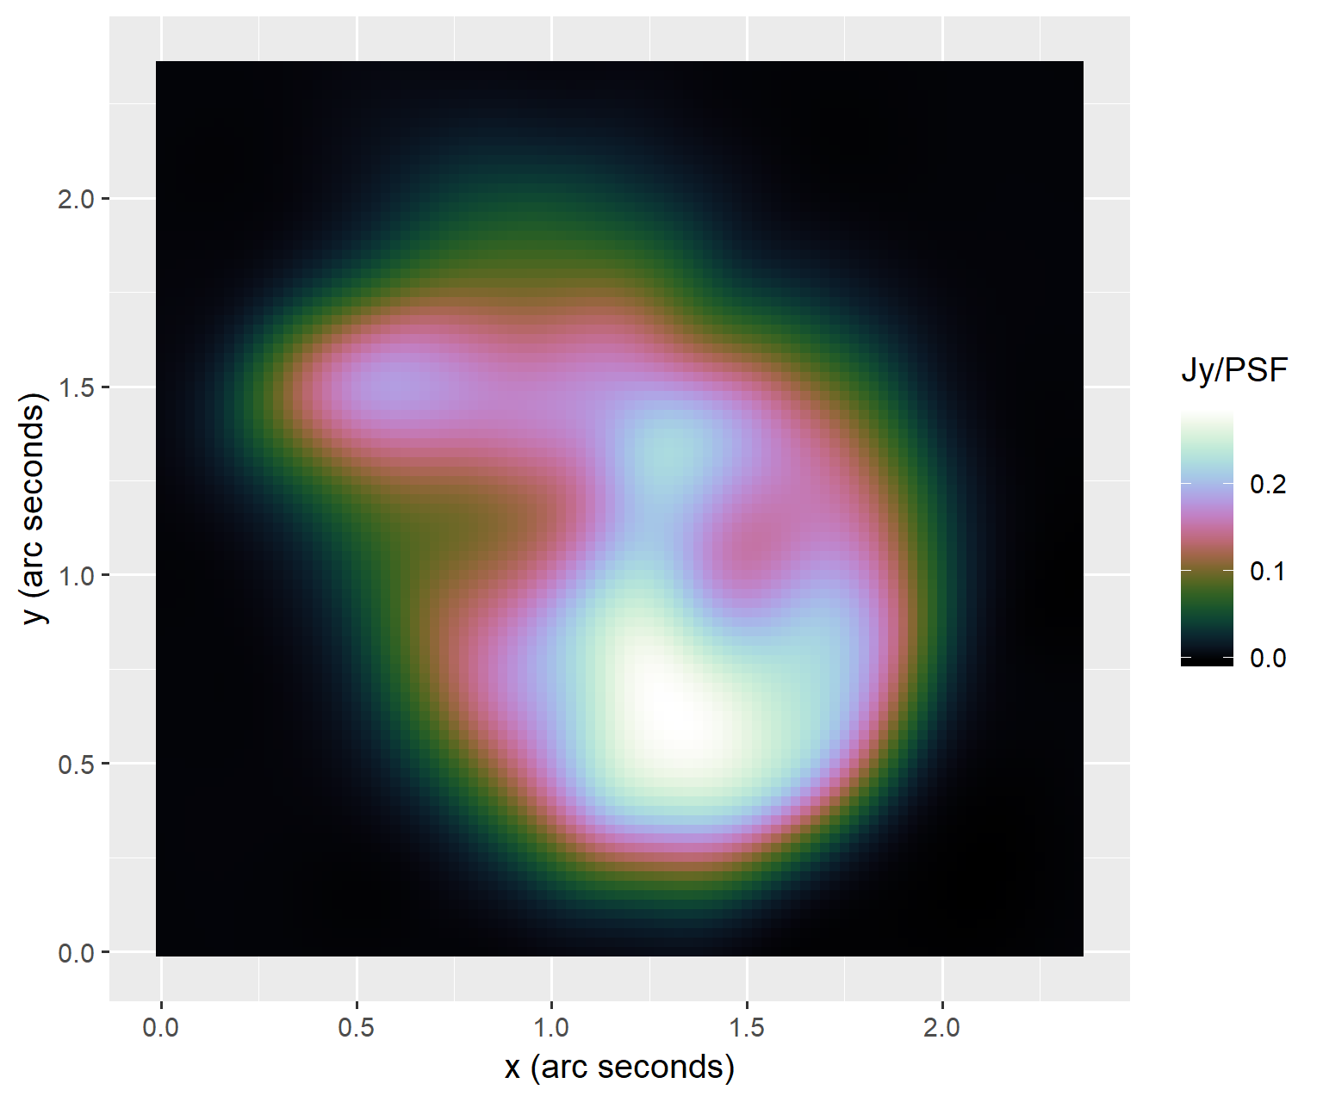
MS-CLEAN
Coordinate Descent
MS-CLEAN Briggs restored

Slide 15
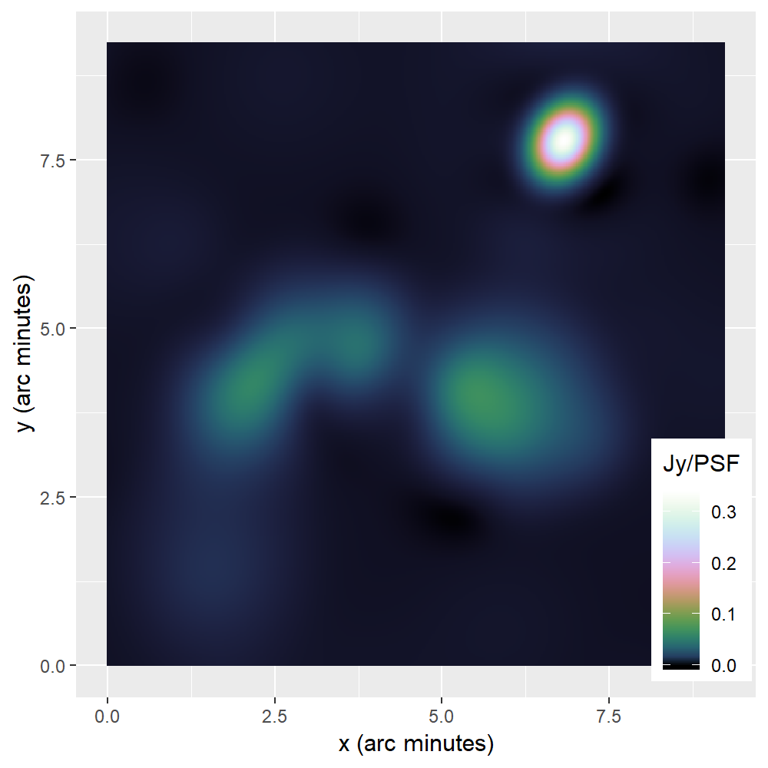
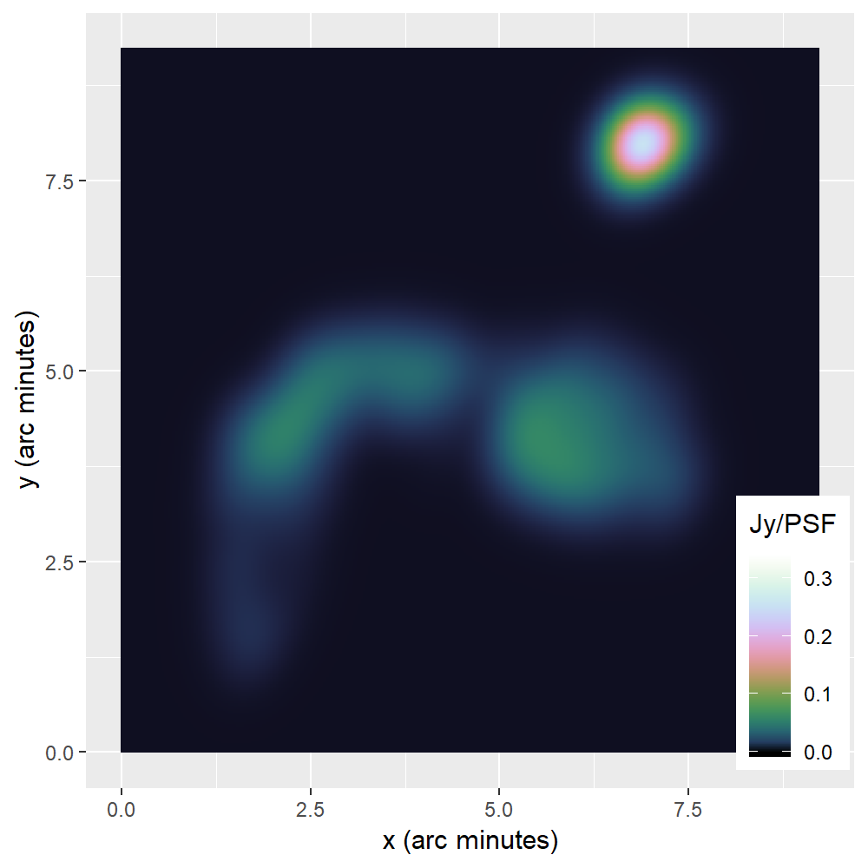
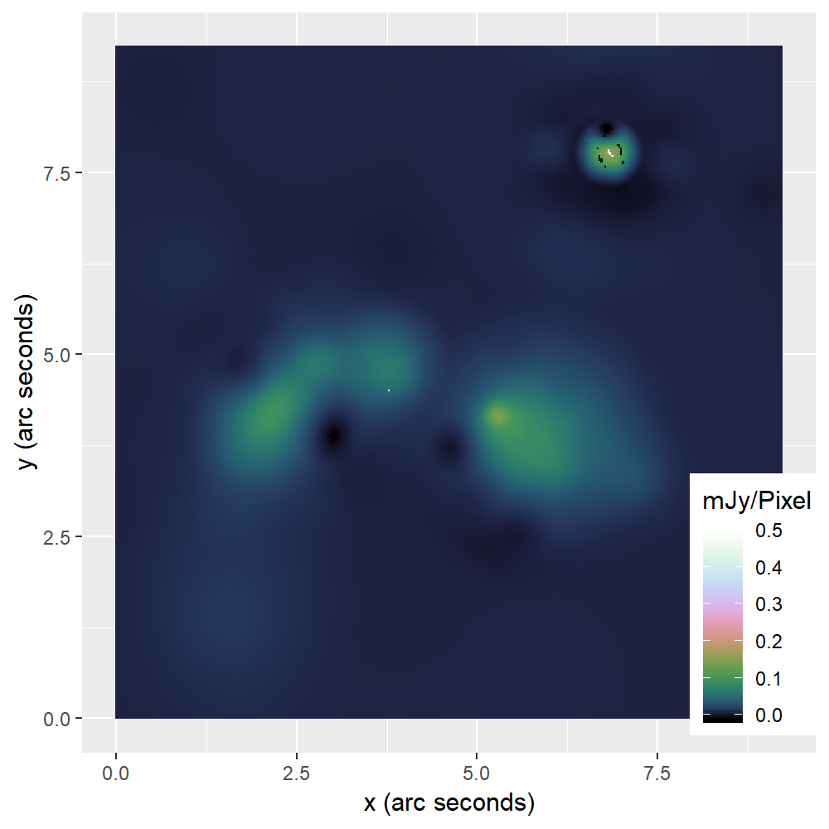
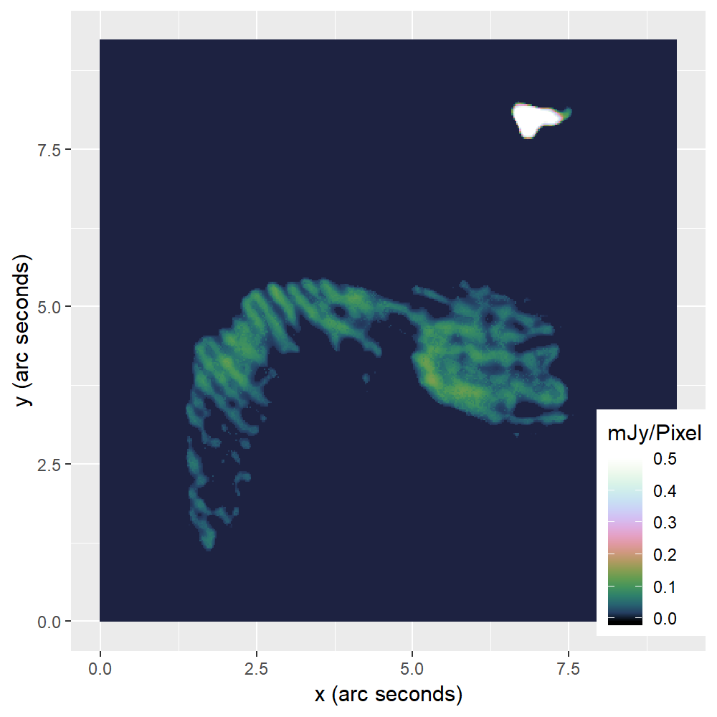
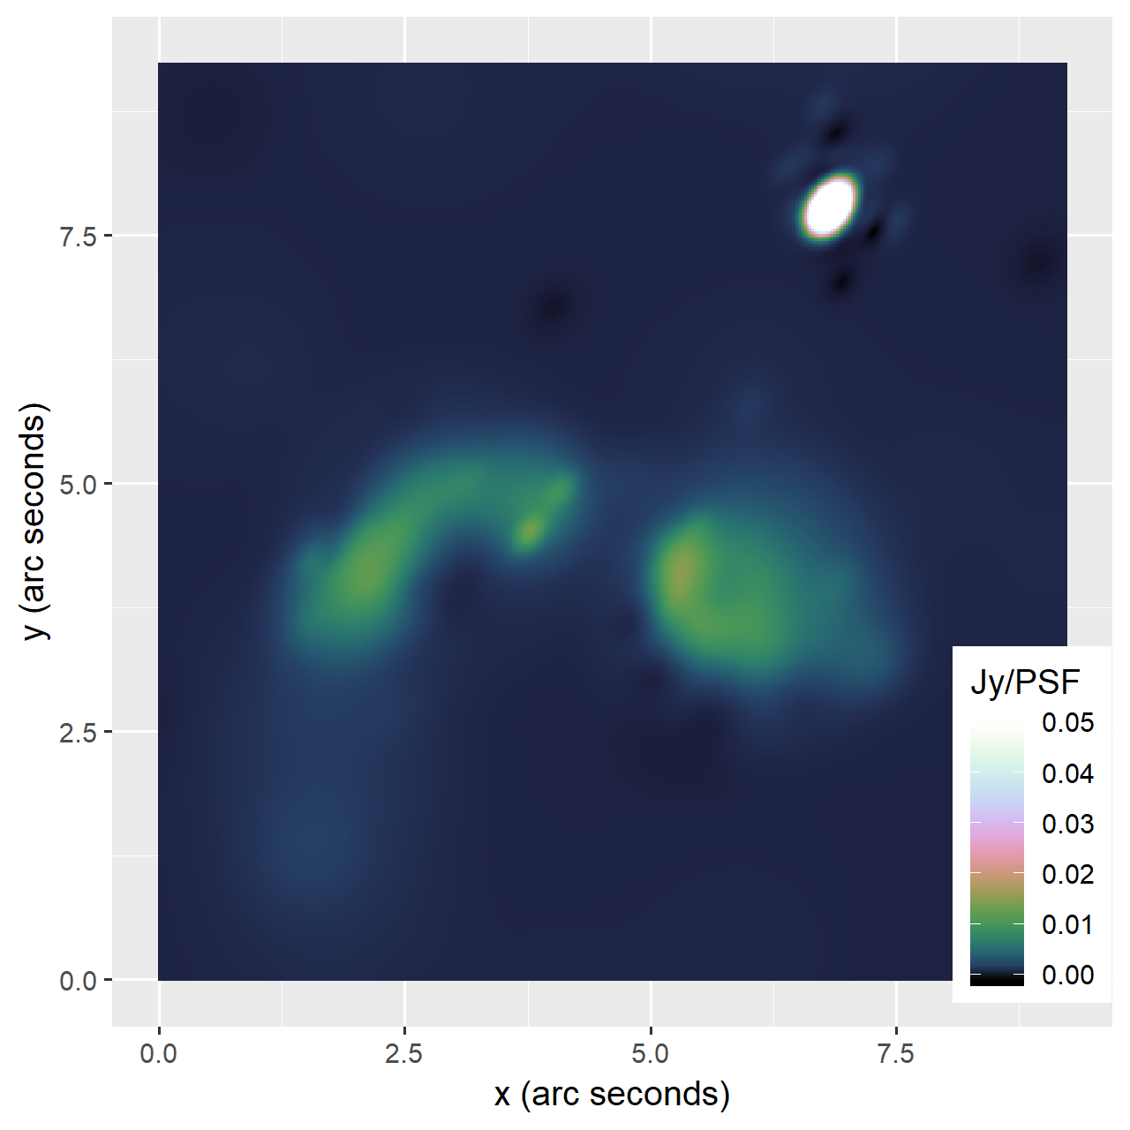
MS-CLEAN
Coordinate Descent
MS-CLEAN Briggs restored

Slide 16
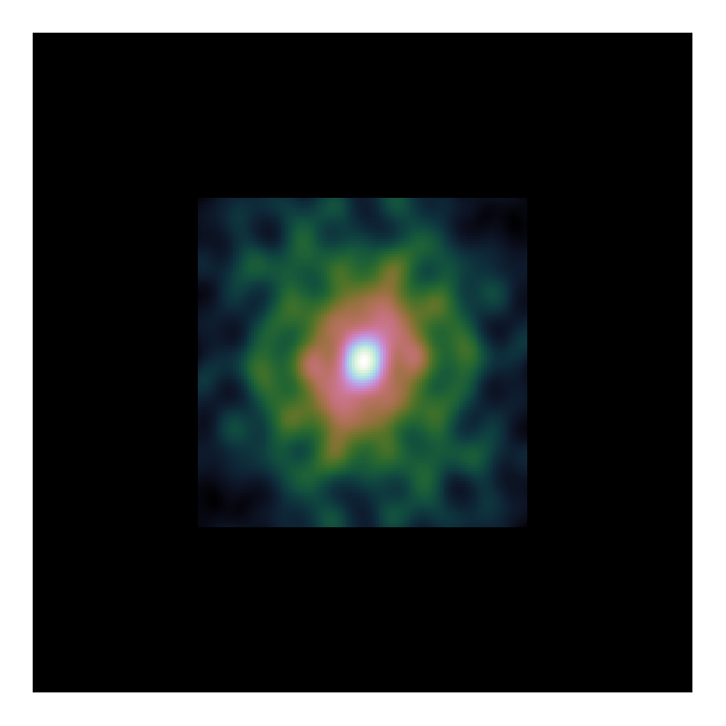
Serial Coordinate Descent VS CLEAN
CLEAN: 15’000 iterations
Serial coordinate descent: 100’000 iterations
GPU acceleration is not enough

Slide 17
Parallel updates

Slide 18
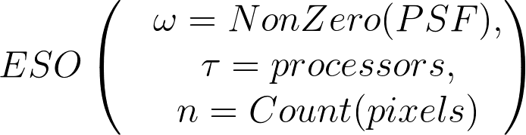
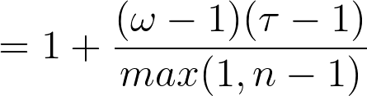
Estimated Separability Over-approximation (ESO)

Slide 19
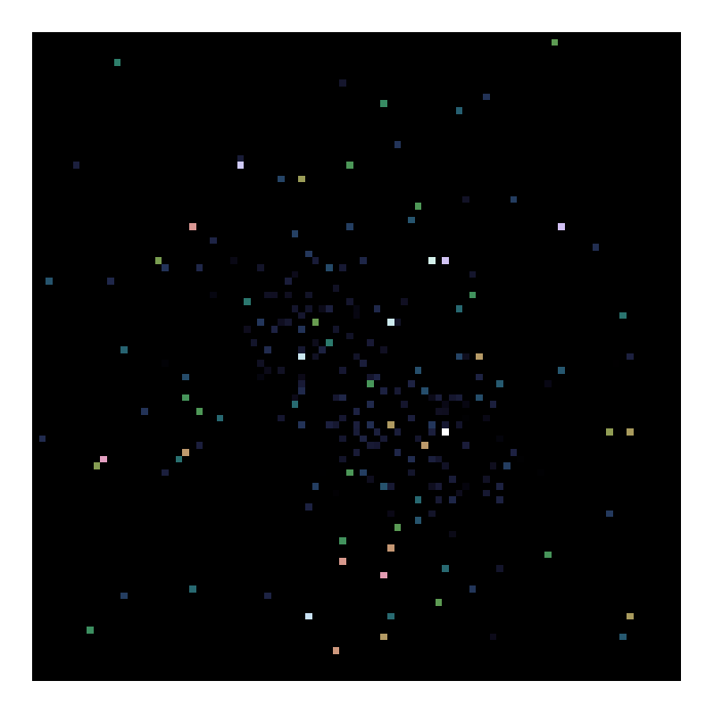
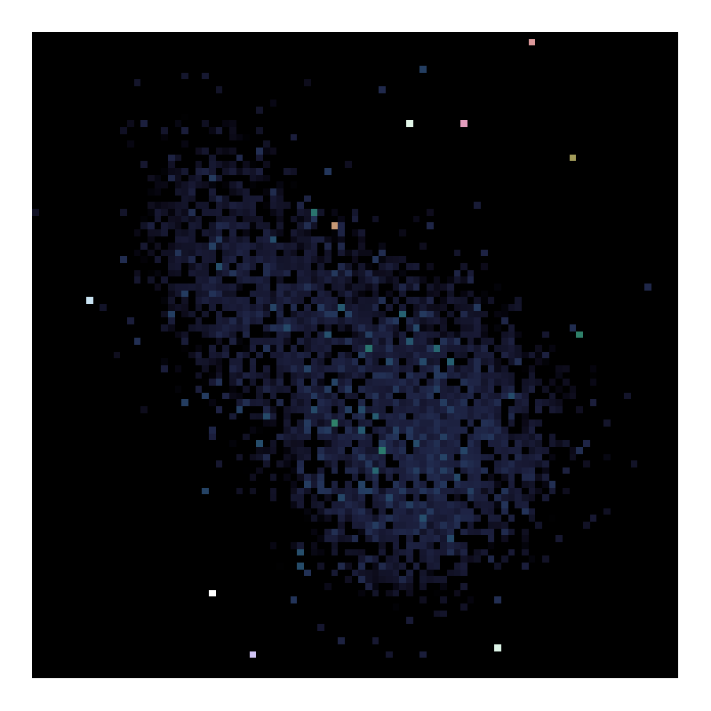
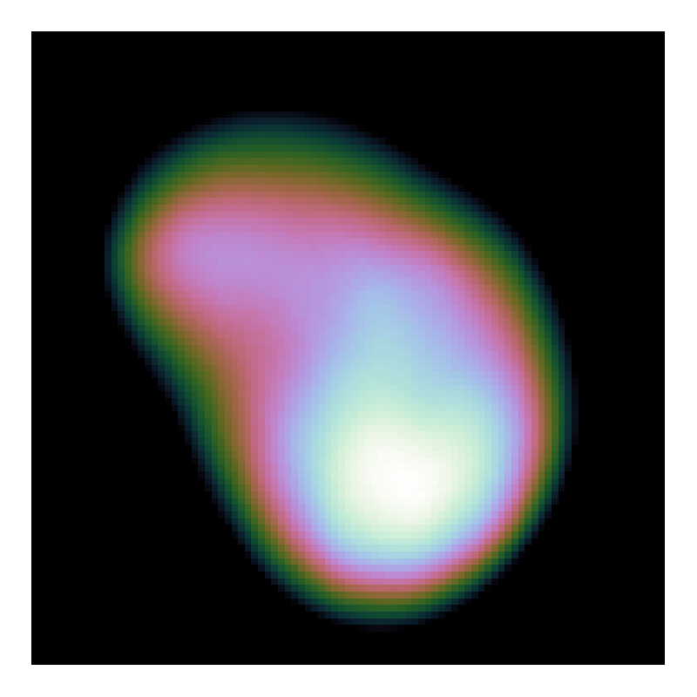
Random Selection Strategy
8k iterations
80k iterations
50k iterations
Random Pixel Selection
Pseudo-Random Selection

Slide 20
Parallel CD
Adaption: Pseudo-Random Selection Strategy
Asynchronous implementation
Benefits from PSF approximation

Slide 21
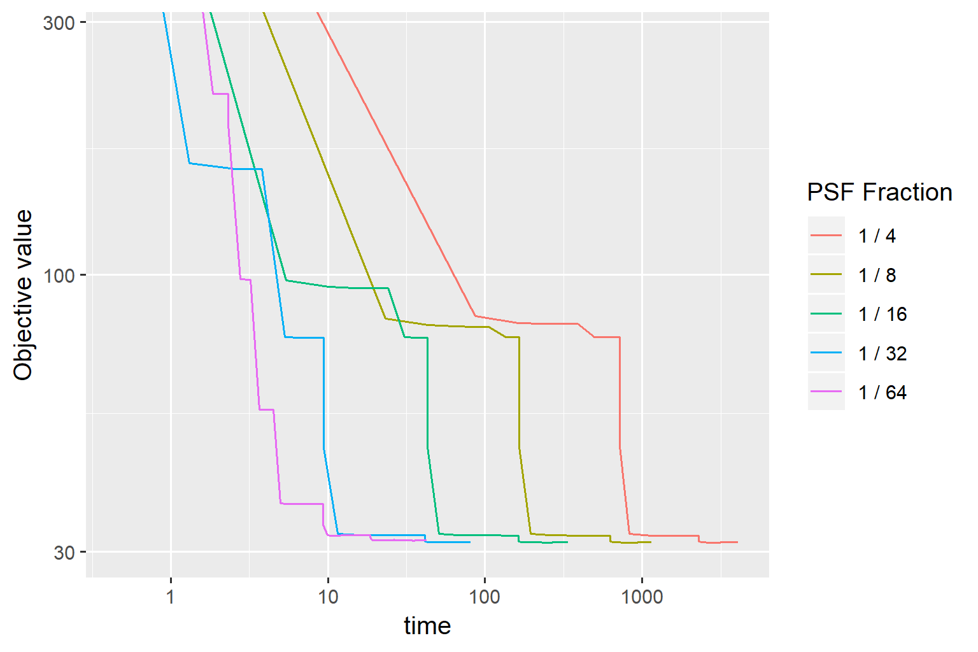
Speedup PSF Approximation

Slide 22
Comparison to CLEAN
Parallel Coordinate Descent:
20x faster than Serial CD
3x faster than CLEAN

Slide 23
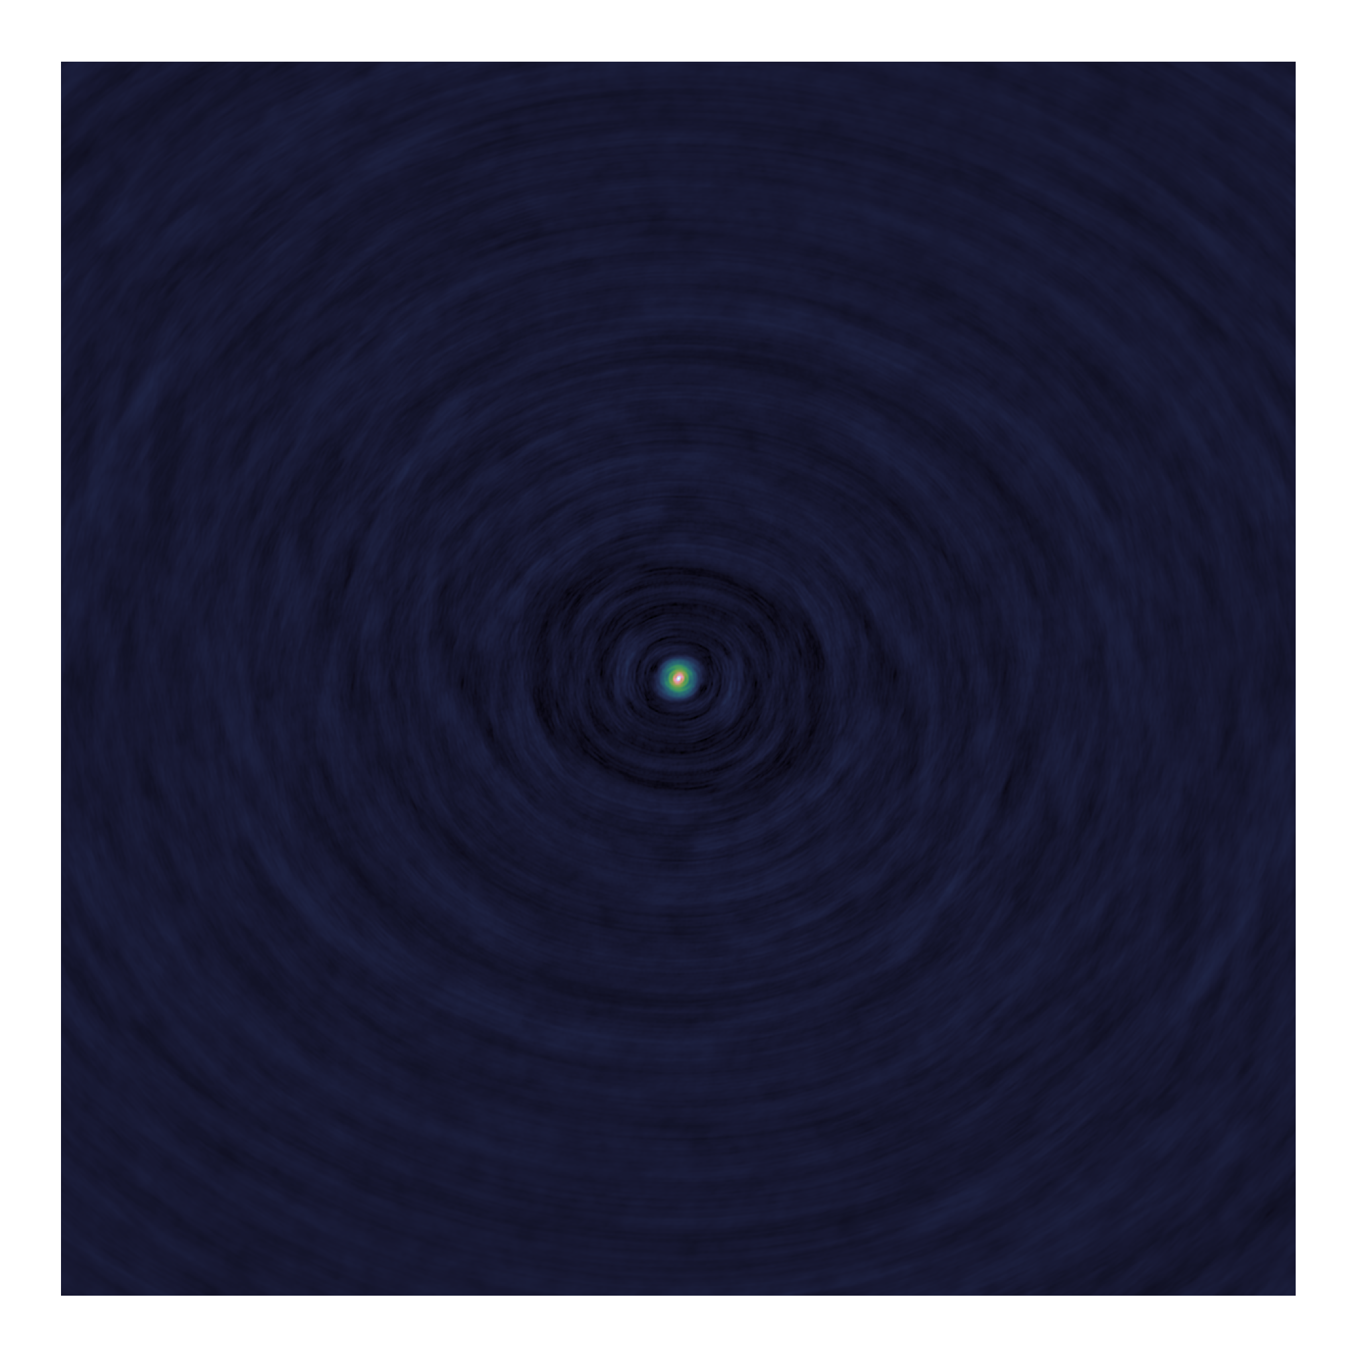
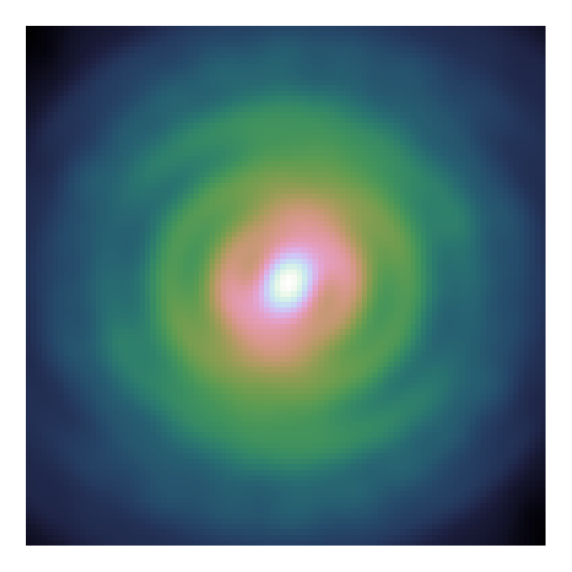
Scalability

Slide 24
Conclusion
Problem with facets
How much distribution
How useful is elasticnet

Slide 25
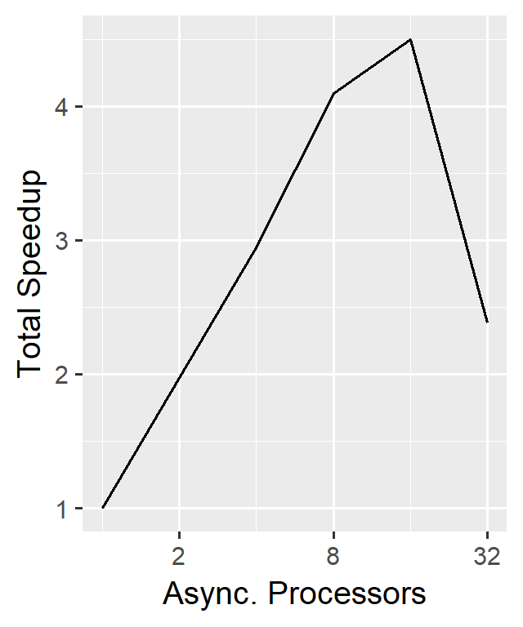
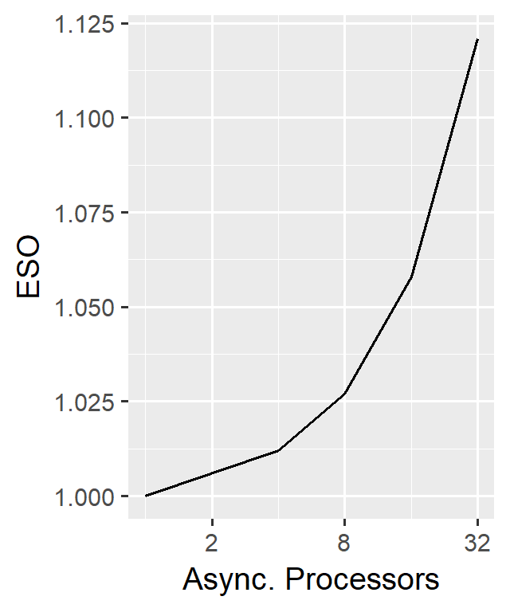
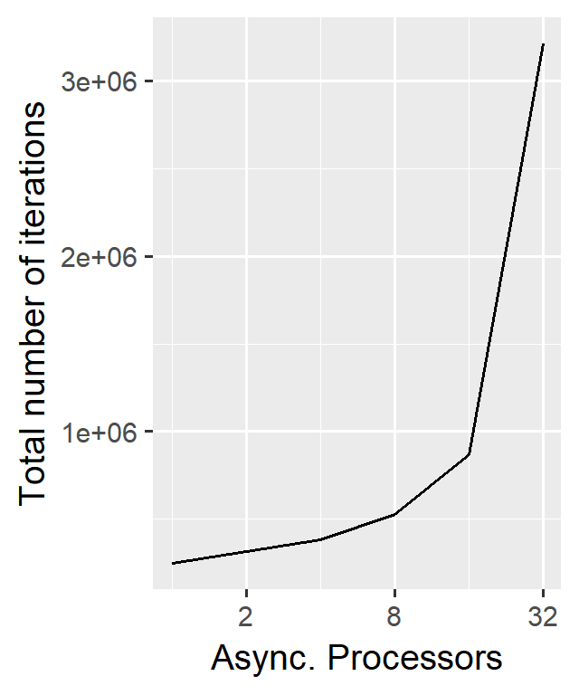
Scalability

Slide 26
Test
Table

